Slide 1


Data Exploration
Abdullah Qayyum

Slide 2

Income Dataset
The data set I used in my project is called the income data set and it tells you about the following for an individual:
Age
Work class
Education
Martial Status
Occupation
Race
Sex
Hours worked per week
Native country
Income > 50k
Capital loss
Capital Gain
I found this data to be very interesting because they are so many question that popped up in my mind that are very interesting. I am very excited to find some interesting patterns in this data set.

Slide 3
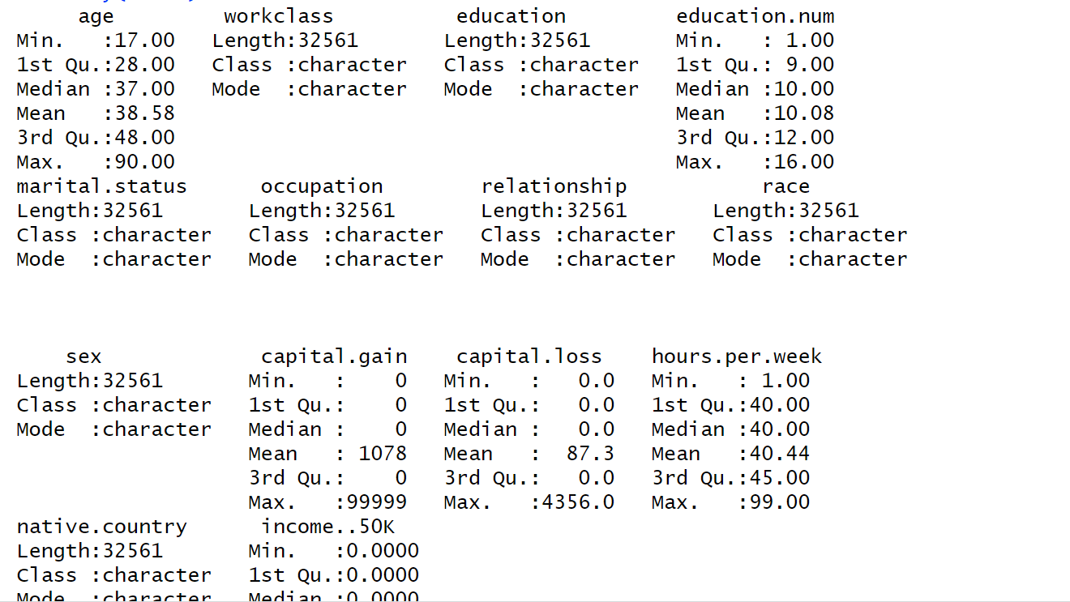
Data Summary
This data has a mixture of characters and numeric modes. There are a lot of interesting things that the summary says about the data. The data to be seems real since the max age is 90 and the average hours worked is about 40 hours, which is the normal number of hours people work in the United States.

Slide 4
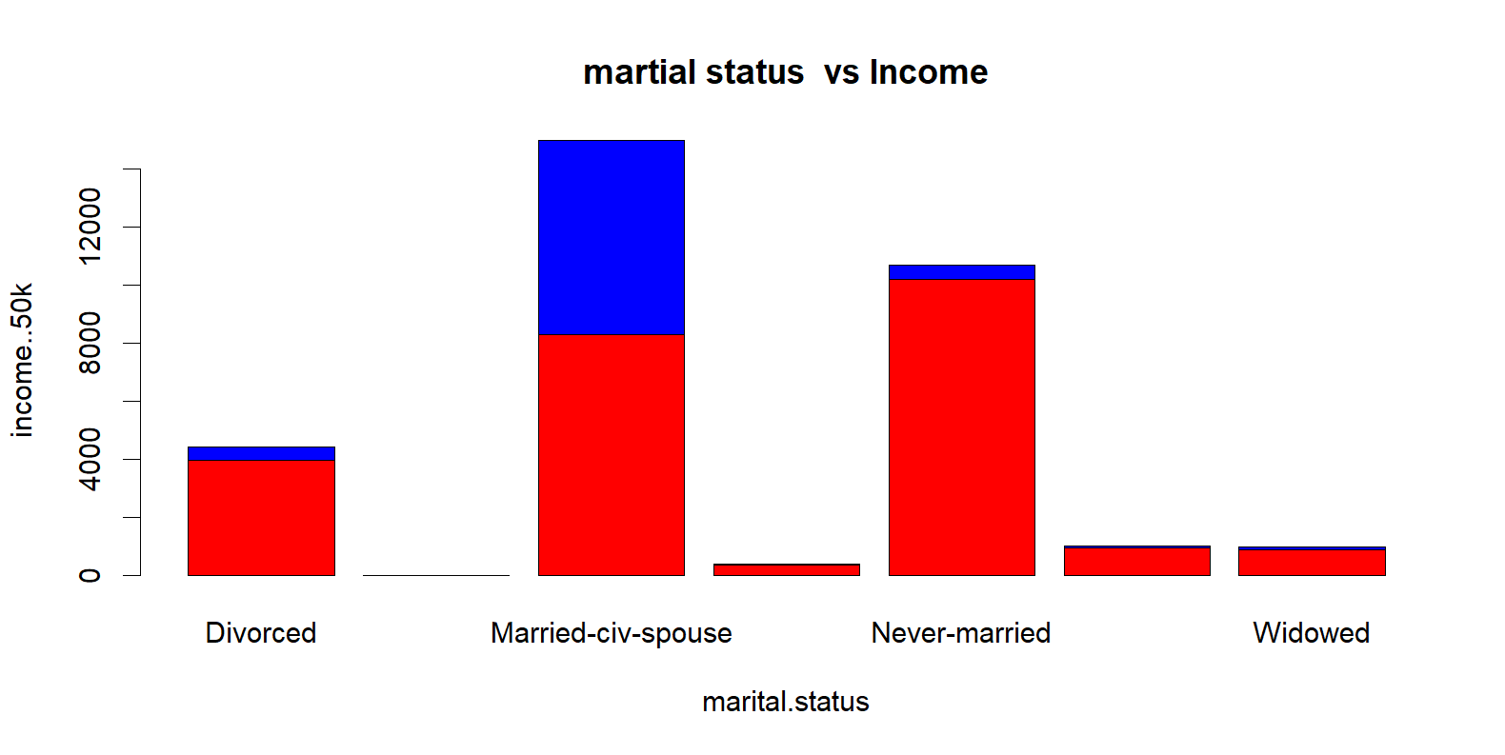
1st Interesting Find
In the graph, the red bars represent individuals earning less than 50k, while the blue bars represent those earning more than 50k. Notably, when we examine the divorce category, we observe a stark contrast – the red part (3980) significantly outnumber the blue part (463). This observation suggests a compelling trend: individuals with higher incomes appear to have a substantially lower likelihood of experiencing divorce when compared to their counterparts with lower incomes.

Slide 5

Income Vs Divorce
How does income level correlate with divorce rates: Do individuals with lower incomes tend to have higher divorce rates, or is there a higher divorce rate among those with higher incomes?
Based on the analysis of this dataset, it appears that there is an inverse relationship between income levels and divorce rates. Specifically, individuals with higher incomes tend to experience lower divorce rates, whereas those with lower incomes are more likely to have higher divorce rates.

Slide 6
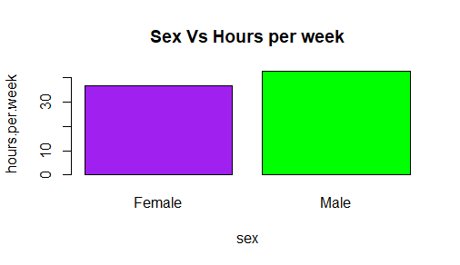
2nd Interesting Find
This graph provides an overview of the average working hours for males and females. On the X-axis, we have gender, and on the Y-axis, we have hours per week. The data reveals that, on average, females work approximately 36.41 hours per week, while males work around 42.42 hours per week. From this dataset, it's evident that, on average, males work more hours than females.

Slide 7
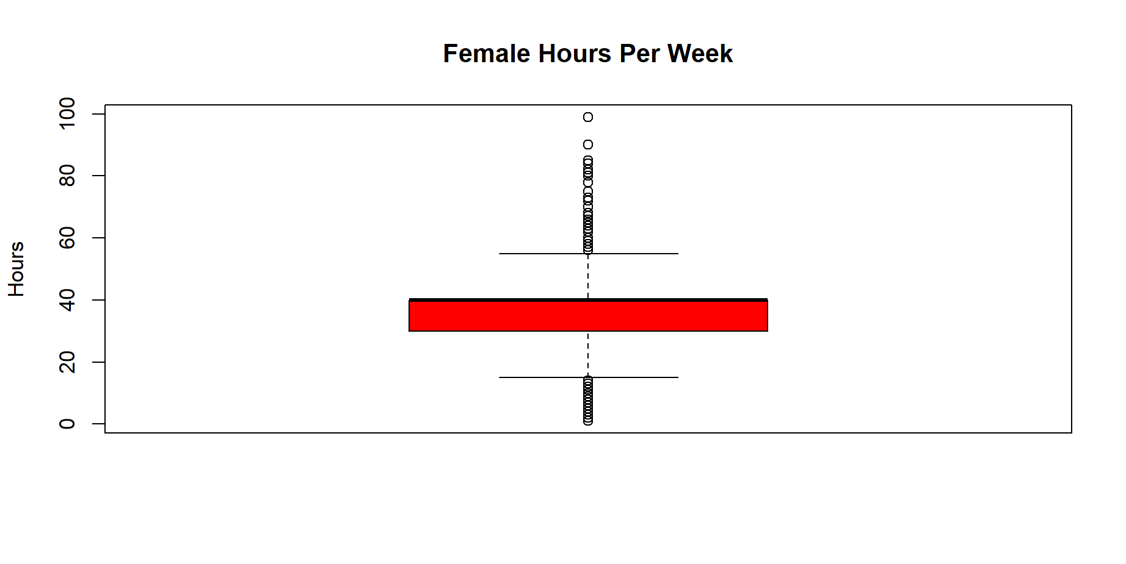
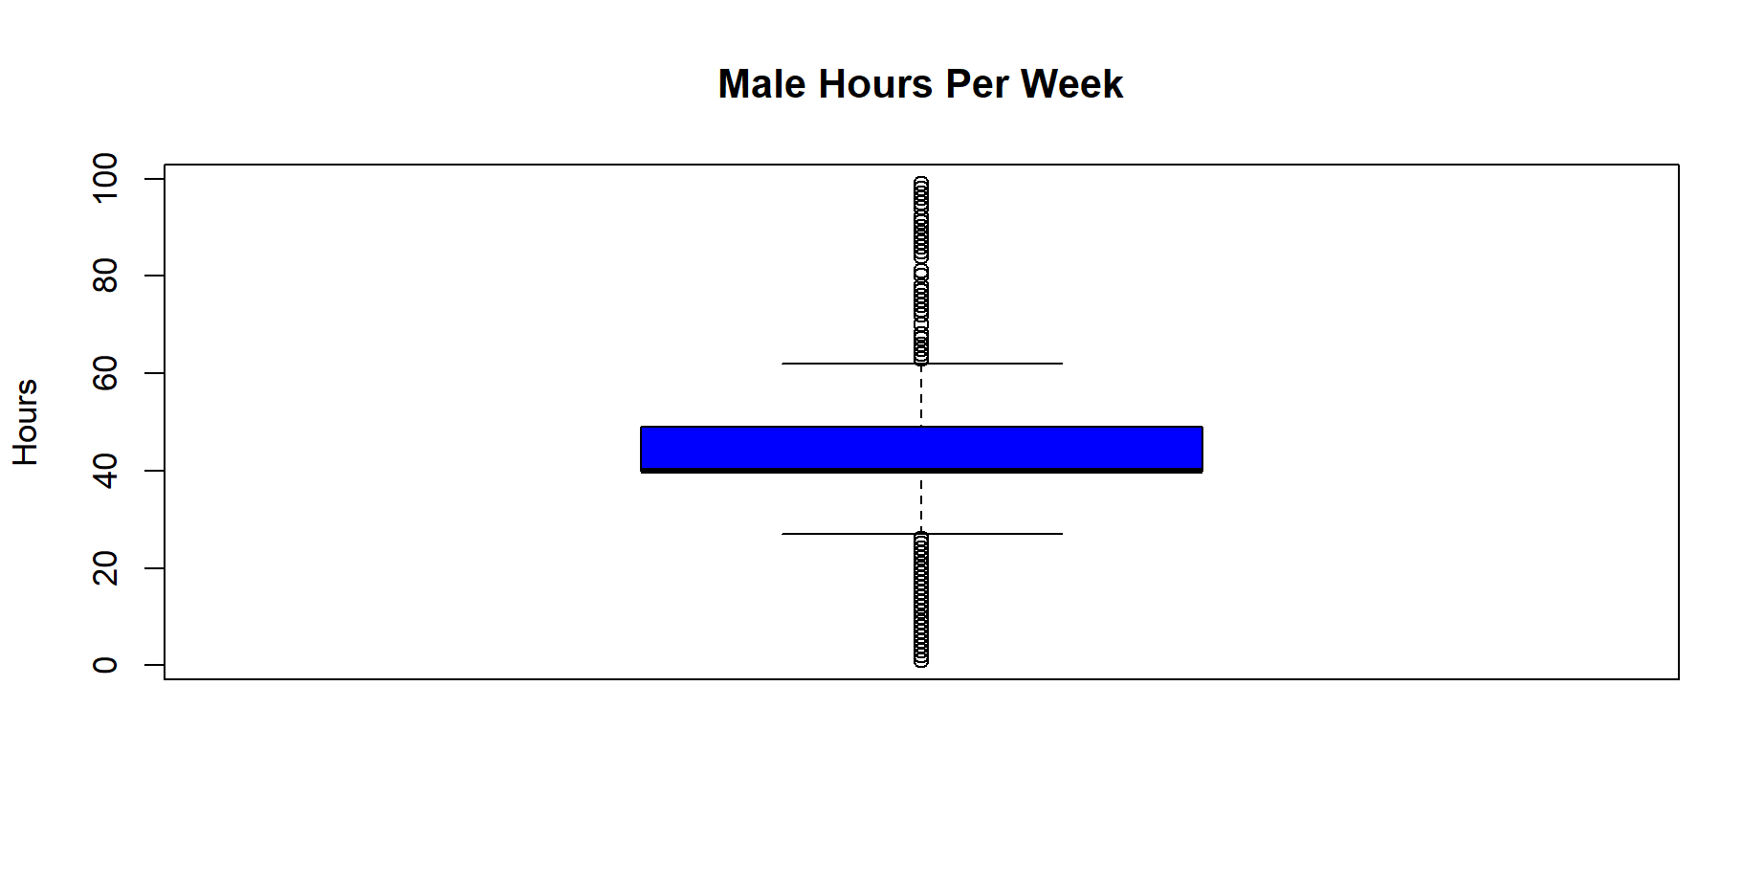
Box Plots Sex vs Hours Per Week
These box plots illustrate the average hours worked by males and females, as well as the range from the minimum to the maximum hours worked. In this visualization, females are represented by the red plot, and males by the blue one. An apparent observation is the difference in the median (the middle value) of the box plots, indicating that, on average, males work more hours than females.

Slide 8
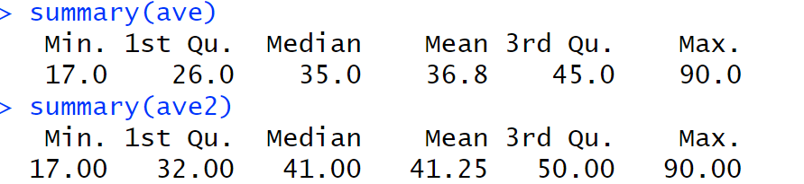
Average Ages of People Working Private vs Gov Jobs
The average age of individuals in private-sector jobs stands at 36.8 years, while those in government employment have an average age of 41.25 years. This finding may appear unexpected, as one might assume that individuals in private jobs tend to be older. However, it's important to note that government jobs often include a significant number of older workers. The age range for both groups spans from a minimum of 17 to a maximum of 90 years.
Below are the summaries for private jobs(the top one) and gov jobs(the bottom one).

Slide 9
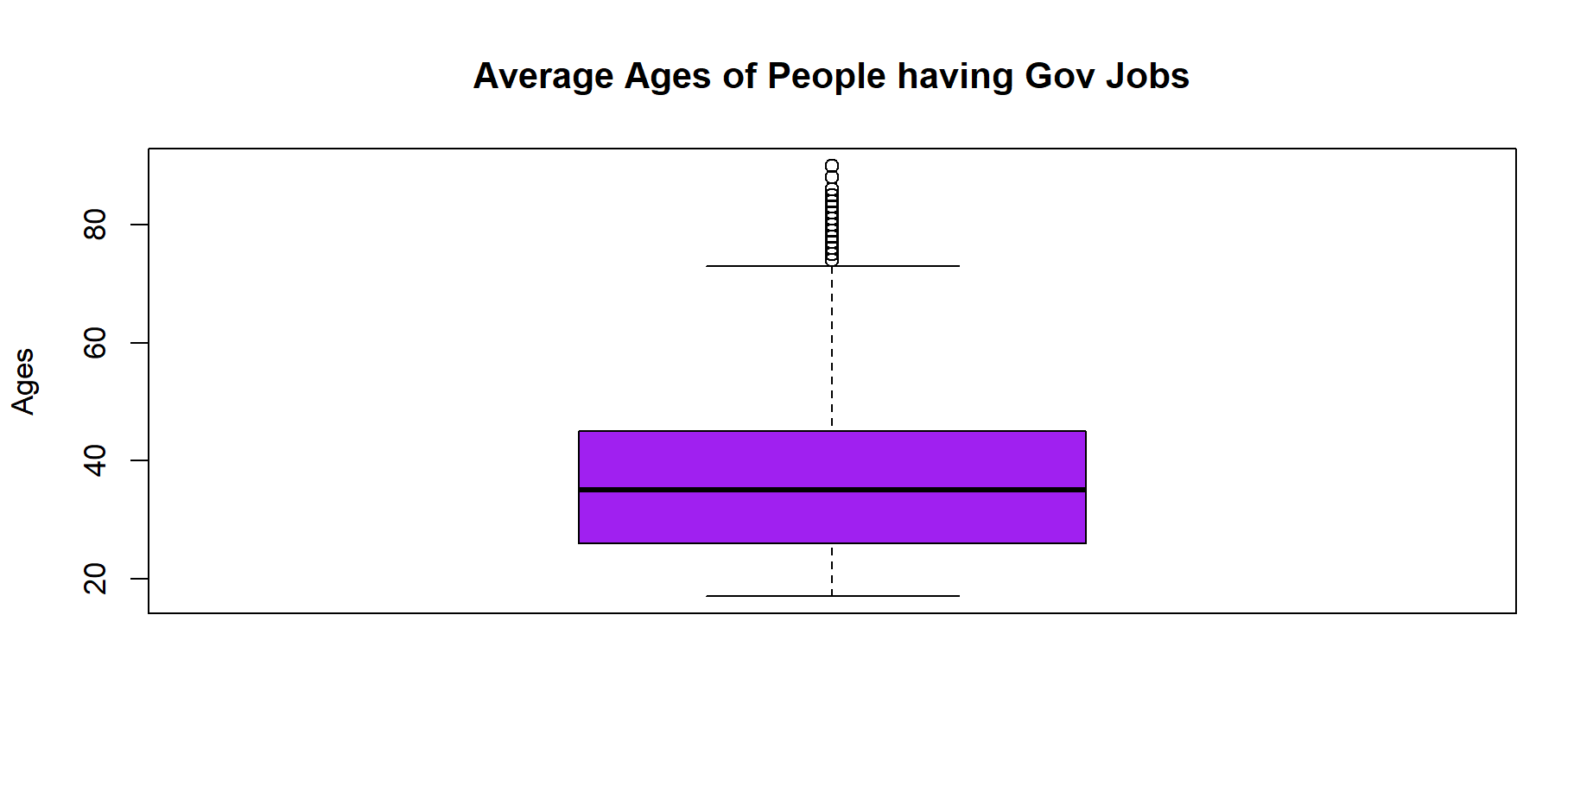
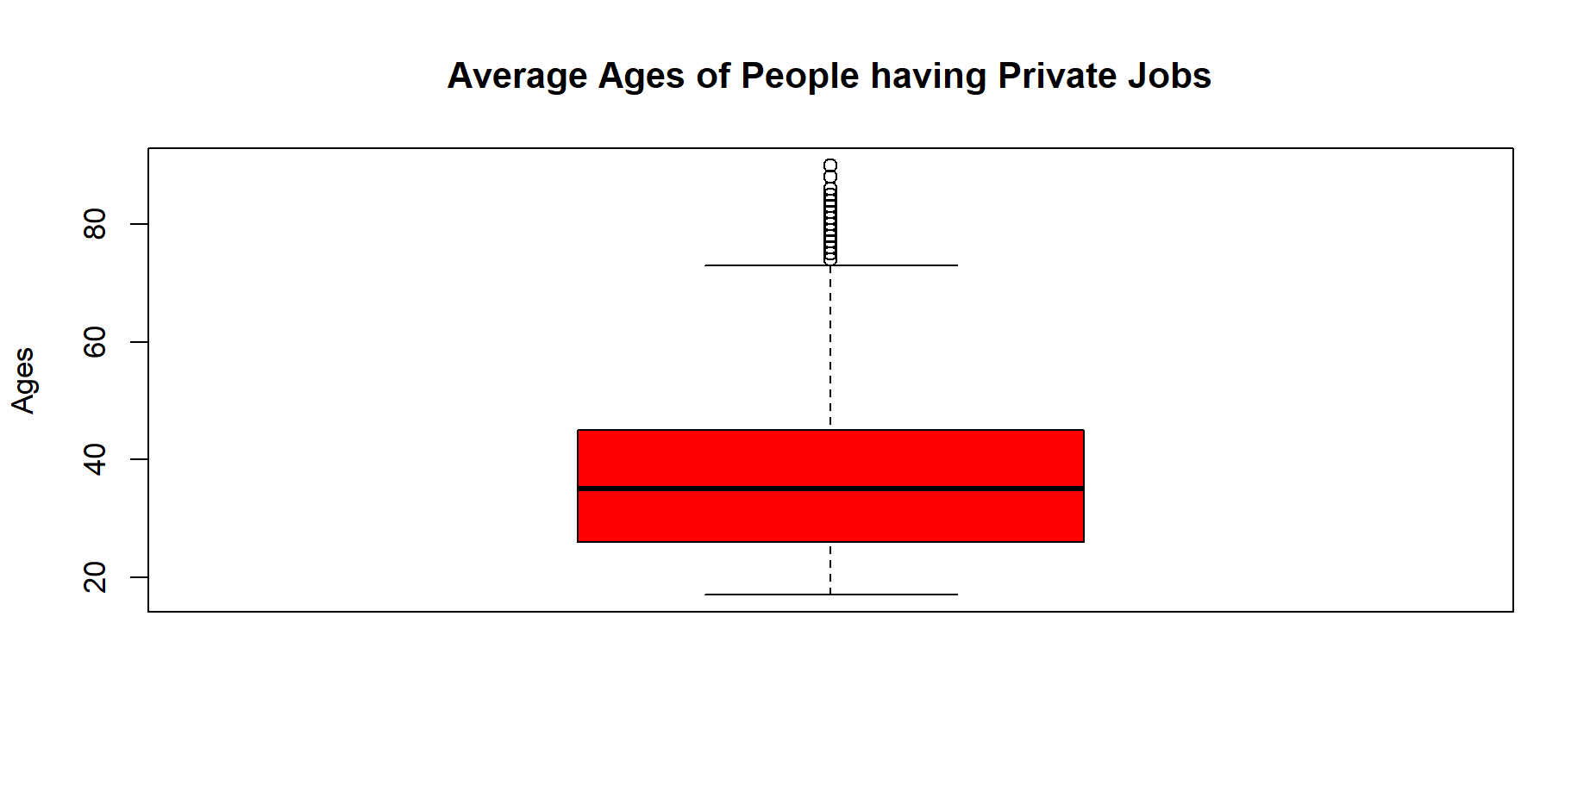
Box Plots Average Age of Private Vs Gov Jobs
Notice the clear shift in the median between the purple and red box plots. In the red box plot, the median is 35, while in the blue plot, it rises to 41. This substantial difference in the median values underscores the contrast between the two data sets.

Slide 10

The End

